Slide 1
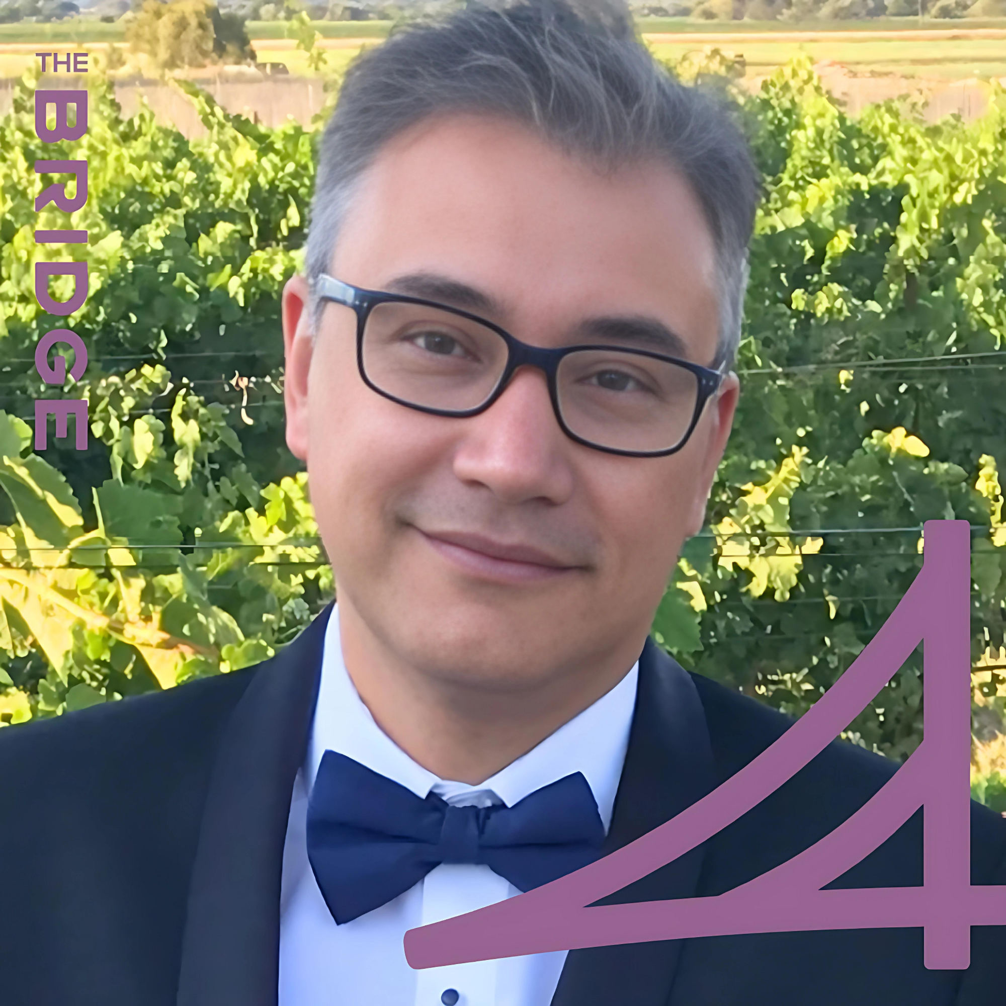
Eduardo Nava Senior Manager — Acceleration
Email
Eduardo.nava@thebridge.com
Location
Austin, Texas
Mobile
(408) 373-3606
Eduardo, joined to The Bridge since March 2024, boasts over 19 years of executive-level expertise in project and program management consulting. His distinguished career underscores a track record of adeptly steering cross-functional initiatives within the dynamic landscape of the global technology industry
EXPERIENCE
Industry Experience
Financial Services | Technology | Automotive | Healthcare | Manufacturing | Retail | Government | Real Estate
DevOps Implementation | Real Estate
Served as Technical Program Manager, leading DevOps initiatives and implementing best practices for Continuous Integration and Continuous Delivery in AWS Cloud architecture. Developed and deployed Power BI dashboards to extract and showcase Atlassian Jira data for informed leadership decisions.
Platform Re Engineering | Financial
Led the implementation of the company's new core platform, coordinating nine SCRUM teams and Product Owners. Administered Atlassian Jira, enhancing dashboards with MS Power BI for improved project visibility and decision-making.
Salesforce Implementation | IT Human Capital Platform
Functioned as a Solution Owner / Program Manager, utilizing Agile expertise to enhance the performance of the Customer Services area using Salesforce. Managed a team of 21 professionals, including Salesforce experts, analysts, developers, and testers.
Business Intelligence & Security Portfolio | Healthcare
Program Manager, played a pivotal role in overseeing applications within the BI and Security portfolios. Key projects under Eduardo leadership included the successful migration of Oracle E-Business Suite Analytics, upgrading the Teradata Database from version 15.x to 16.x, and implementing Denodo Data Virtualization to version 7x. Additionally, Eduardo served as the manager for support teams, directing operations for tools such as Informatica, Spotfire, Tableau, OBIEE, Denodo, Dell Boomi, MicroStrategy, Oracle Fusion, Hyperion, and Alterix.
BACKGROUND
Functional Skills
Project and Program Management, Agile, Scrum, SAfe, Waterfall, Cloud Architect, Process definition and improvement, Business Intelligence and Data Visualization tools.
Qualifications / Certifications
SAFe 5 Agilist Atlassian badge for Jira Cloud Scrum Master by Scrum.Org SIX SIGMA -Green Belt Certified ITIL Foundations Project Management Professional (PMP) | AWS Solution Architect Microsoft Dynamics CRM Microsoft Business Solution Specialist Microsoft Certified Database Administrator Microsoft Certified Solution Developer MS Power BI

Slide 2

Email
Eduardo.nava@thebridge.com
Location
Austin, Texas
Mobile
(408) 373-3606
Eduardo, joined to The Bridge since March 2024, boasts over 19 years of executive-level expertise in project and program management consulting. His distinguished career underscores a track record of adeptly steering cross-functional initiatives within the dynamic landscape of the global technology industry
Eduardo Nava
Senior Manager
Acceleration

Slide 3
Eduardo Nava Sr. Manager — Acceleration
Email
Eduardo.nava@thebridge.com
Mobile
(408) 373-3606
Location
Austin, Texas
BACKGROUND
EXPERIENCE
Functional Skills
Project and Program Management, Agile, Scrum, SAfe, Waterfall, Cloud Architect, Process definition and improvement, Business Intelligence, and Data Visualization tools.
Qualifications / Certifications
.
Industry Experience
Financial Services | Technology | Automotive | Healthcare | Manufacturing | Retail | Government | Real Estate
DevOps Implementation | Real Estate
Served as Technical Program Manager, leading DevOps initiatives and implementing best practices for Continuous Integration and Continuous Delivery in AWS Cloud architecture. Developed and deployed Power BI dashboards to extract and showcase Atlassian Jira data for informed leadership decisions.
Platform Re Engineering | Financial
Led the implementation of the company's new core platform, coordinating nine SCRUM teams and Product Owners. Administered Atlassian Jira, enhancing dashboards with MS Power BI for improved project visibility and decision-making.
Salesforce Implementation | IT Human Capital Platform
Functioned as a Solution Owner / Program Manager, utilizing Agile expertise to enhance the performance of the Customer Services area using Salesforce. Managed a team of 21 professionals, including Salesforce experts, analysts, developers, and testers.
Business Intelligence & Security Portfolio | Healthcare
Program Manager, played a pivotal role in overseeing applications within the BI and Security portfolios. Key projects under Eduardo leadership included the successful migration of Oracle E-Business Suite Analytics, upgrading the Teradata Database from version 15.x to 16.x, and implementing Denodo Data Virtualization to version 7x. Additionally, Eduardo served as the manager for support teams, directing operations for tools such as Informatica, Spotfire, Tableau, OBIEE, Denodo, Dell Boomi, MicroStrategy, Oracle Fusion, Hyperion, and Alterix.
SAFe 5 Agilist Atlassian badge for Jira Cloud Scrum Master by Scrum.Org SIX SIGMA -Green Belt Certified ITIL Foundations Project Management Professional (PMP) AWS Solution Architect Microsoft Dynamics CRM Microsoft Business Solution Specialist Microsoft Certified Database Administrator Microsoft Certified Solution Developer MS Power BI

Slide 4









 | USE OVER DARK BACKGROUND | USE OVER LIGHT BACKGROUND
STRATEGY & ADVISORY
DATA & AI
EXPERIENCES
CLOUD & PRODUCT
ACCELERATION

